Slide 1
CHAPTER 14:
MOMENTUM II
(INDIVIDUAL INDICATORS)

Slide 2
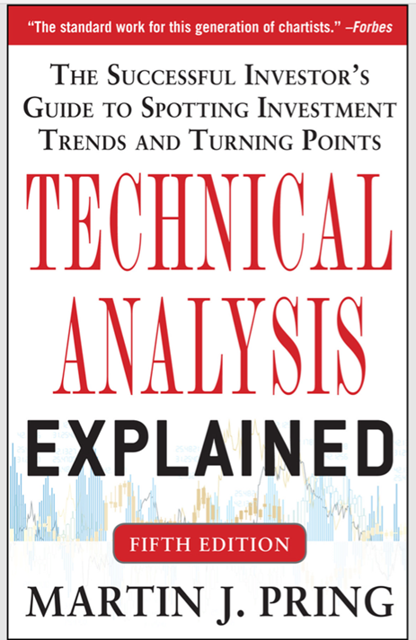
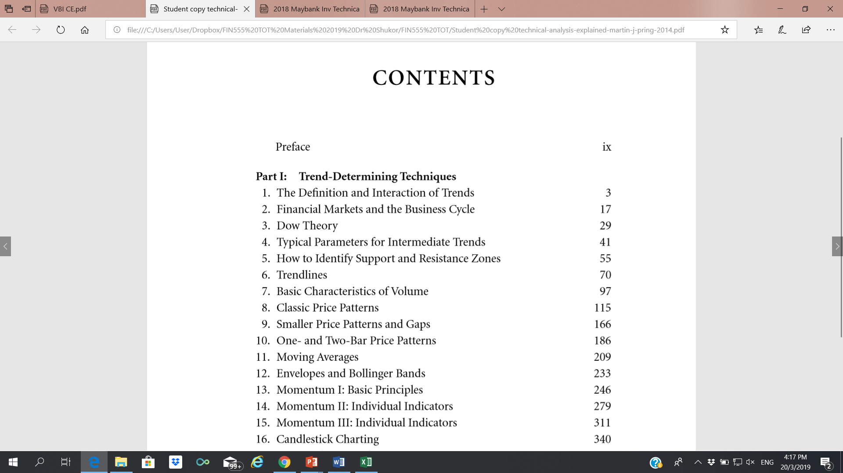
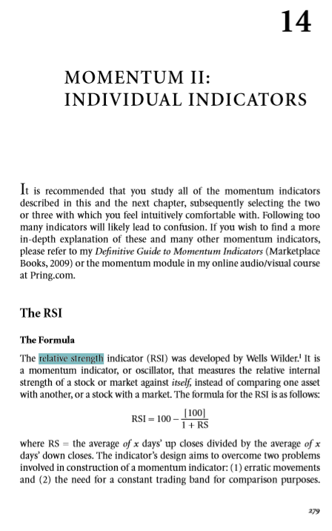
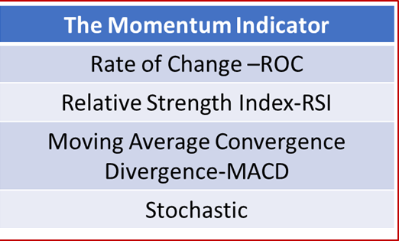
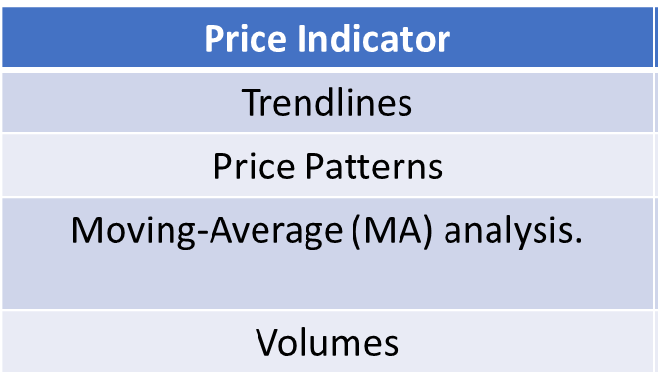

The Momentum Indicators
The Momentum Indicator: (Rate of Change -ROC)
The Momentum Indicator: (Relative Strength Index- RSI)
The Momentum Indicator: (Moving Average Convergence Divergence -MACD)
The Momentum Indicator: (Stochastic)
1) Rate of Change –ROC)
RSI
MACD
Stochastic

Slide 3
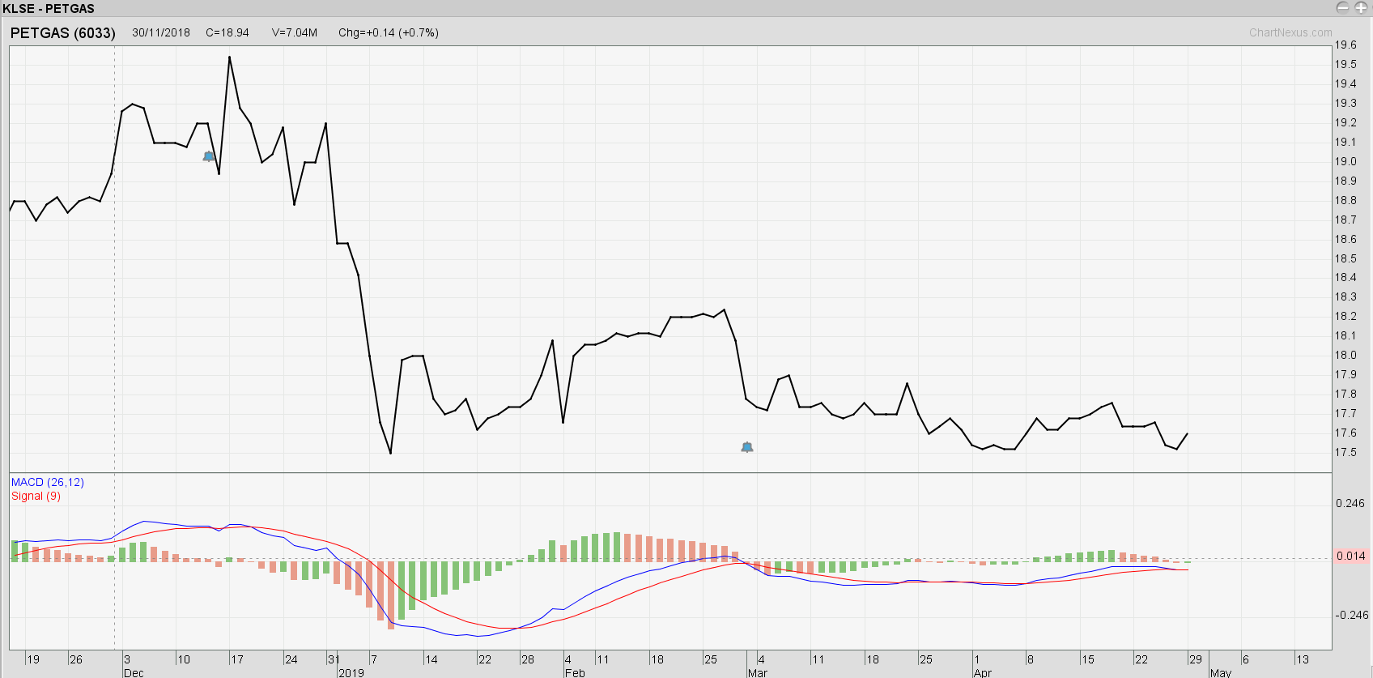
MOMENTUM INDICATOR 3:
THE MOVING-AVERAGE CONVERGENCE DIVERGENCE (MACD)

Slide 4
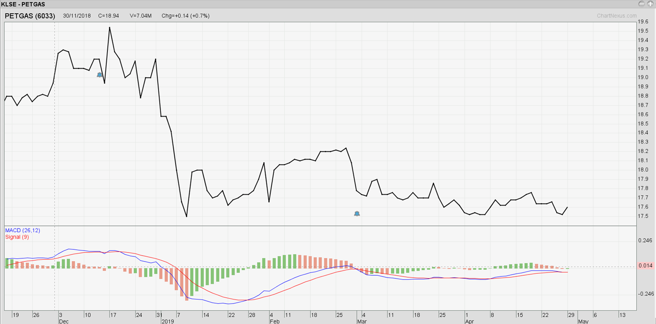
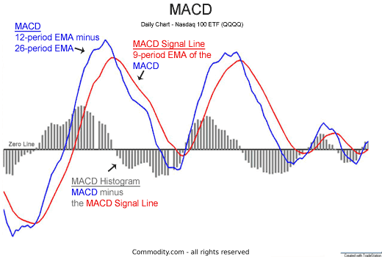
MACD
The MACD indicator is an effective and versatile tool. Besides signaling buy/sell indicators, the MACD can also be used to sound out potential change in trading direction for stocks and futures.
There are three main components of the MACD:
  MACD: This line is plotted based on the difference between the 12-day and 26-day exponential moving averages (EMA)
  MACD Signal Line: This is a 9-day EMA of the MACD
  MACD Histogram: Each bar of the histogram represents the difference between the MACD and the MACD Signal Line

Slide 5
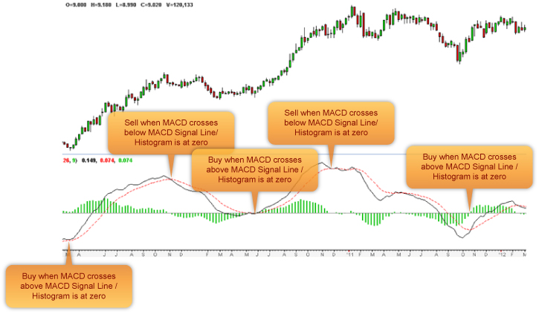

Reading the signals is simple and straightforward. At the point of the MACD crossing over the MACD Signal Line, a trading buy/sell signal is given. This is further confirmed by the MACD Histogram.

Slide 6
Buy: This is signaled by the MACD crossing above the MACD Signal
Sell: This is signaled by the MACD crossing below the MACD Signal
The buy/sell signals are also confirmed by the MACD Histogram.

Slide 7
As mentioned earlier, MACD Histogram is the difference between the EMAs. Each bar represents the difference between the two moving averages on that date. The interpretation of the MACD Histogram is as follows:
At zero: The two moving averages have the same numerical value – they have zero difference between them.
Bar grows taller: Divergence is growing as difference increases. This indicates that the trend will continue.
Bar shrinks: The two moving averages are converging, watch out for a signal change.
Buy: When the MACD histogram is below the zero line and begins to converge towards the zero line. The point of convergence coincides with the MACD crossing over the MACD Signal and indicates the buying point.
Sell: When the MACD histogram is above the zero line and begins to converge towards the zero line. The point of convergence coincides with the MACD crossing below the MACD Signal and indicates the selling point.

Slide 8
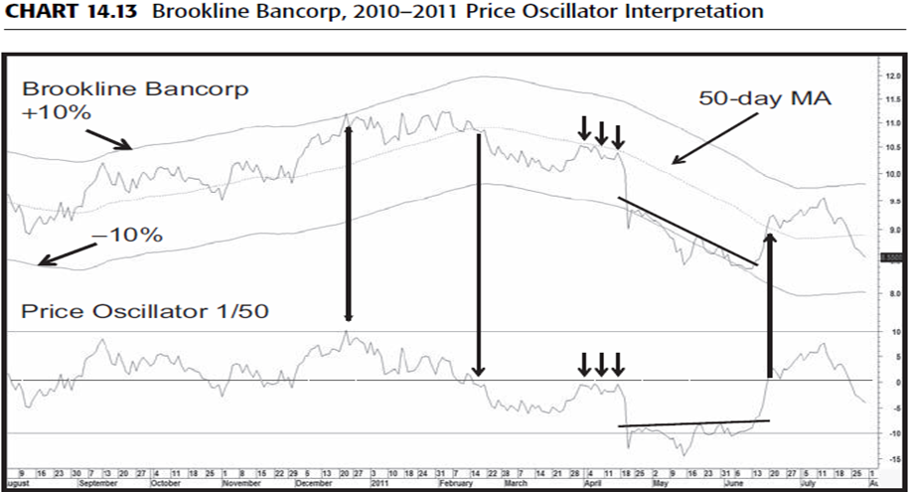
MACD
The moving-average convergence divergence (MACD) trading method is form of trend-deviation indicator using two exponential moving averages, the shorter being subtracted from the longer.
The two MAs are usually calculated on an exponential basis in which more recent periods are more heavily weighted than in the case of a simple MA. It is normal for the MACD to then be smoothed by a third exponential moving average (EMA), which is plotted separately on the chart.
This average is known as the “signal line,” the crossovers of which generate buy and sell signals. It obtains its name from the fact that the two EMAs are continually converging and then diverging from each other.
The MACD has gained great popularity over the years, but in effect, it is really just another variation on a trend-deviation indicator that employs two EMAs as its method of deviation. A visual of its construction is therefore very similar to Chart 14.13.

Slide 9
The MACD often works well with monthly data. In this respect, we look at the CRB Spot Raw Industrial Commodity Index in Chart 14.19, where the solid arrows indicate good primary-trend momentum buy signals.
The two dashed ones indicate smaller rallies, which fall into the failure category. The MACD is often plotted in a histogram format and the signal line against it, as in Chart 14.20 featuring Homestake Mining.
The chart shows a classic head-and-shoulders pattern. Note that the MACD histogram gradually became weaker as the pattern progressed.
This was only a short-term sell signal, but the price eventually fell below the signal level.

Slide 10
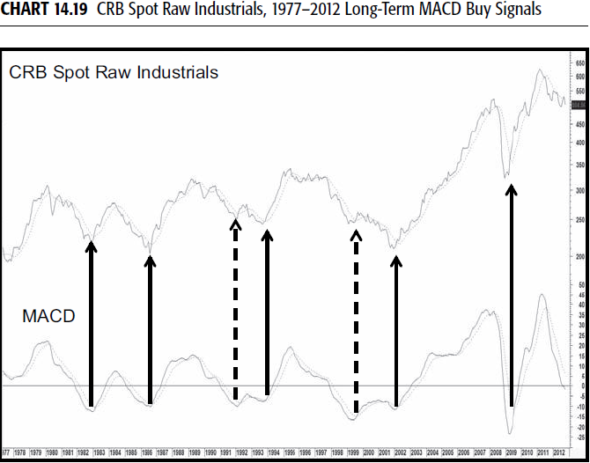

Slide 11
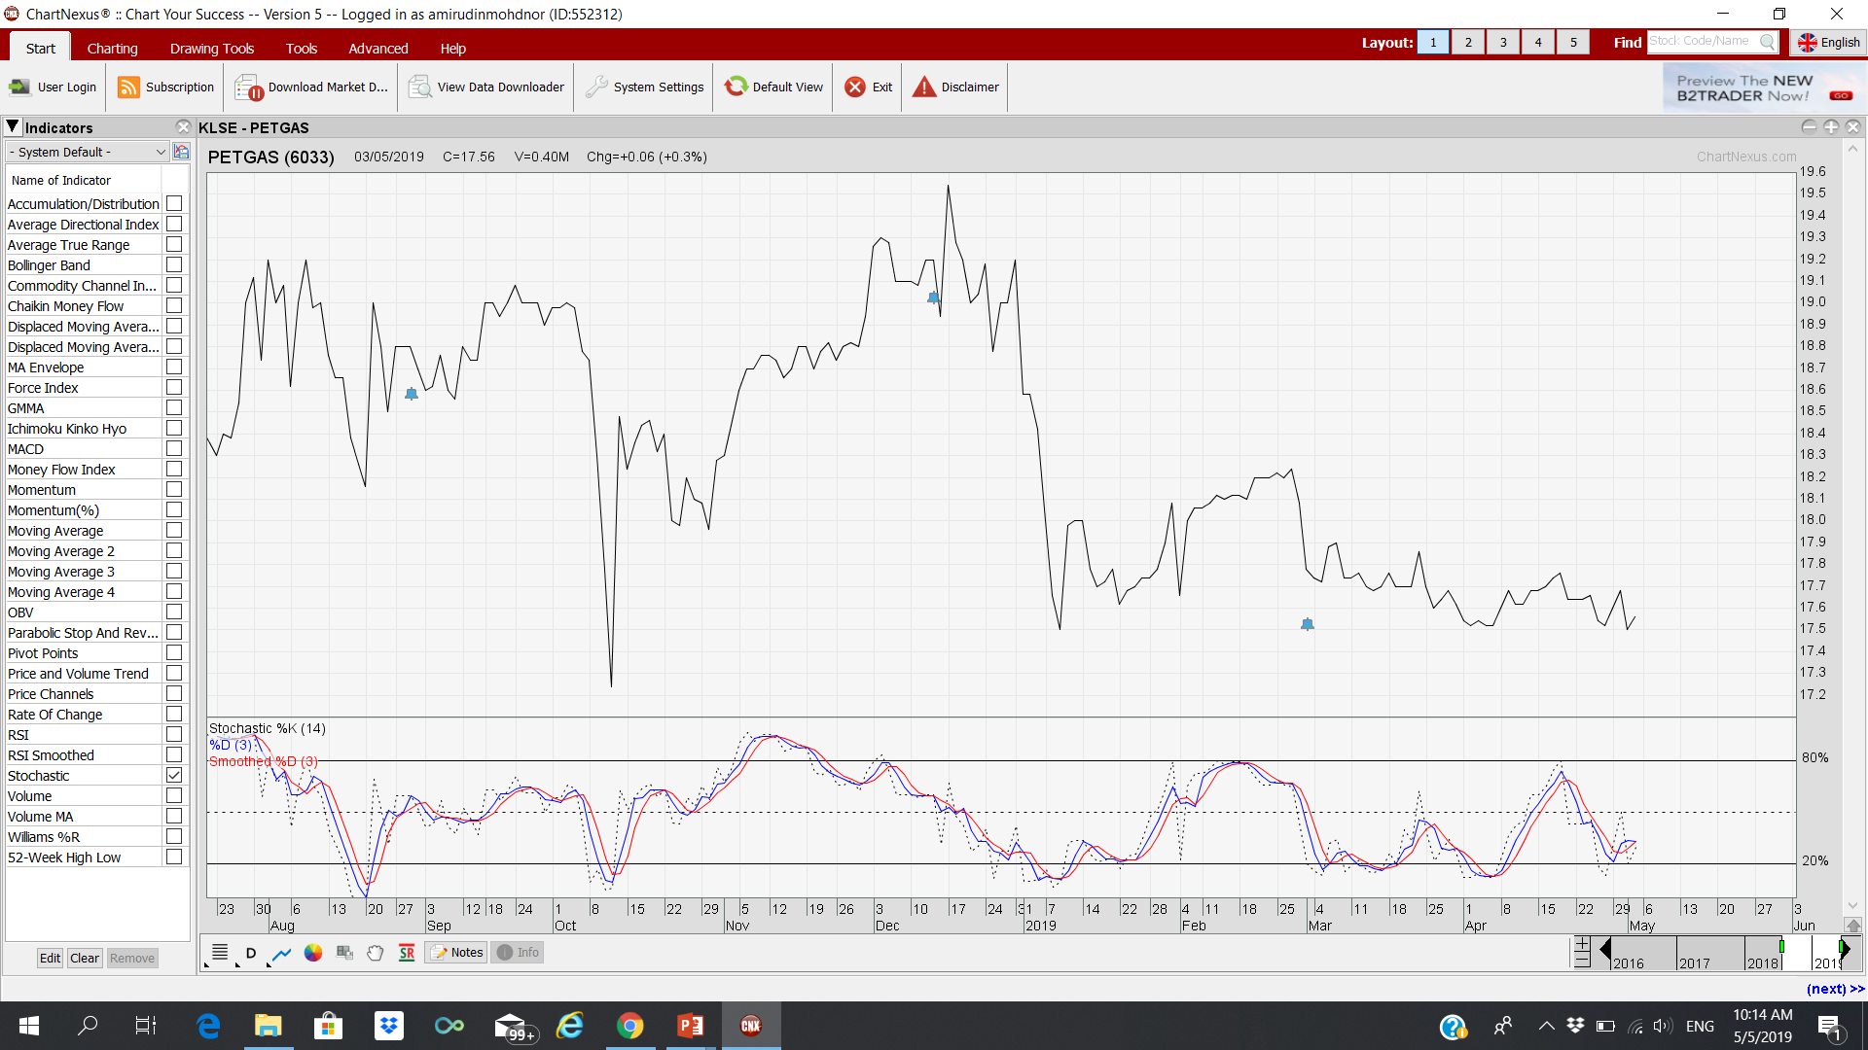
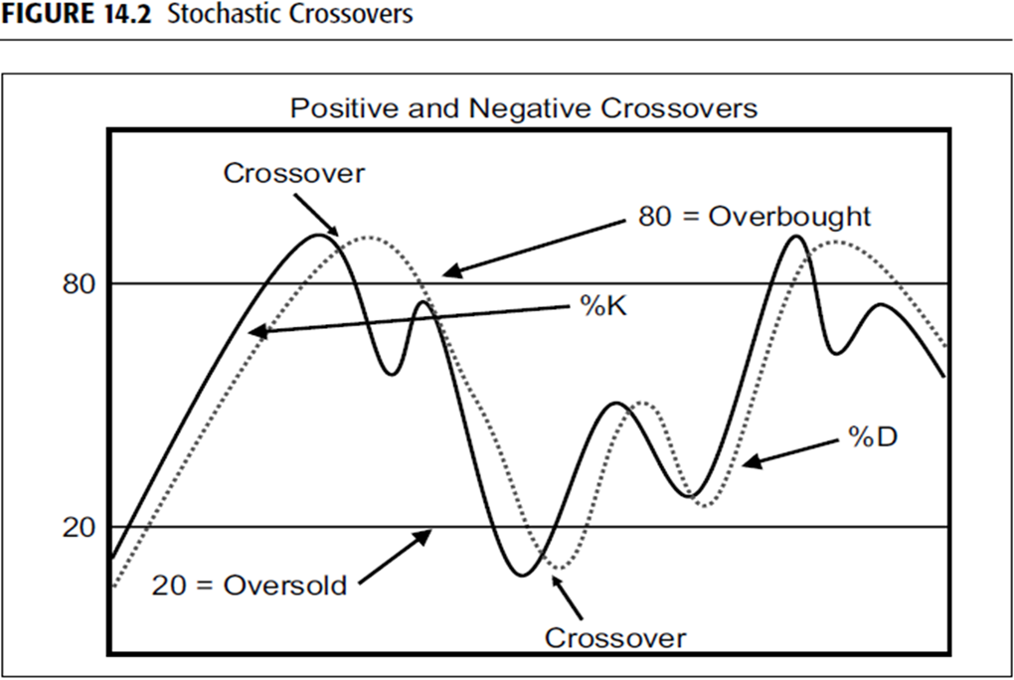
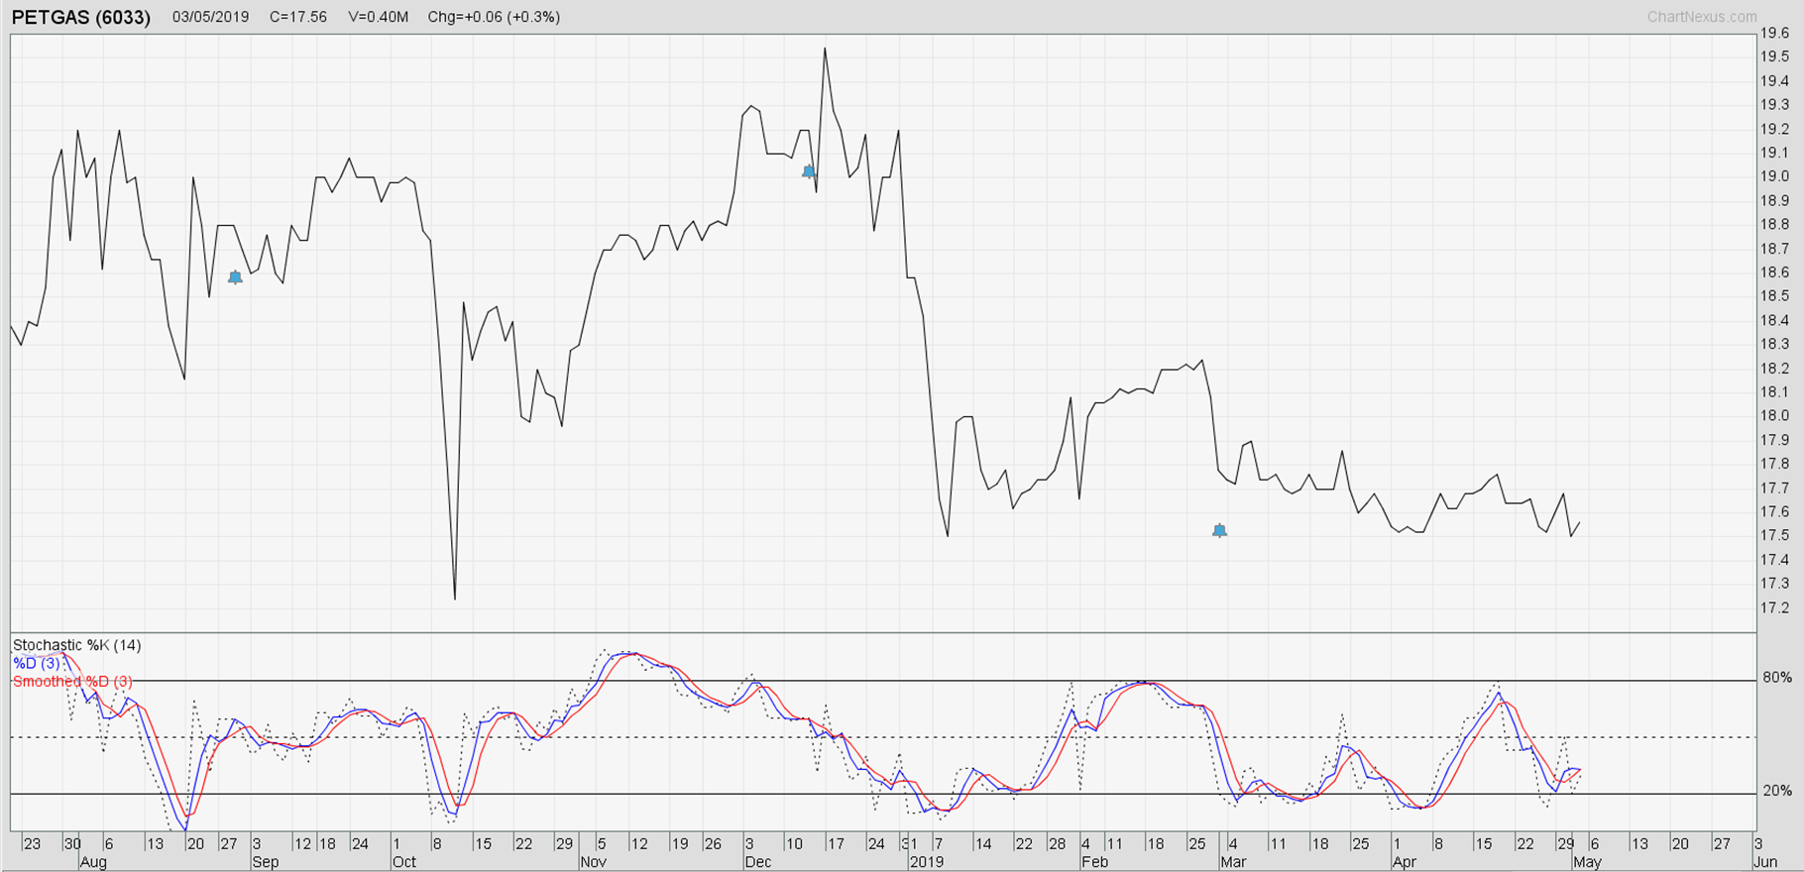
MOMENTUM INDICATOR 4:
STOCHASTICS & Slowed Stochastic
Momentum based Oscillator that help to identify the overbought and oversold area in the market.
Identify where the market is moving over the longer term.

Slide 12
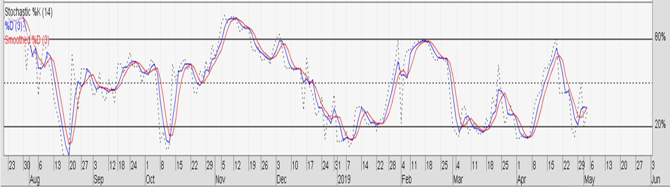
STOCHASTICS
Invented by George Lane: Standard formula uses very short term time spans.
Theory: prices tend to close near the upper end of a trading range during an uptrend. As the trend matures, the tendency for prices to close away from the high of the session becomes pronounced. In a downward-moving market, the reverse conditions hold true.
Measure: Attempts to measure the points in a rising trend at which the closing prices tend to cluster around the lows for the period in question, and vice versa, since these are the conditions that signal trend reversals.
It is plotted as two lines:
  the %K line and the %D line.
  The %D line is the one that provides the major signals and is, therefore, more important.

Slide 13
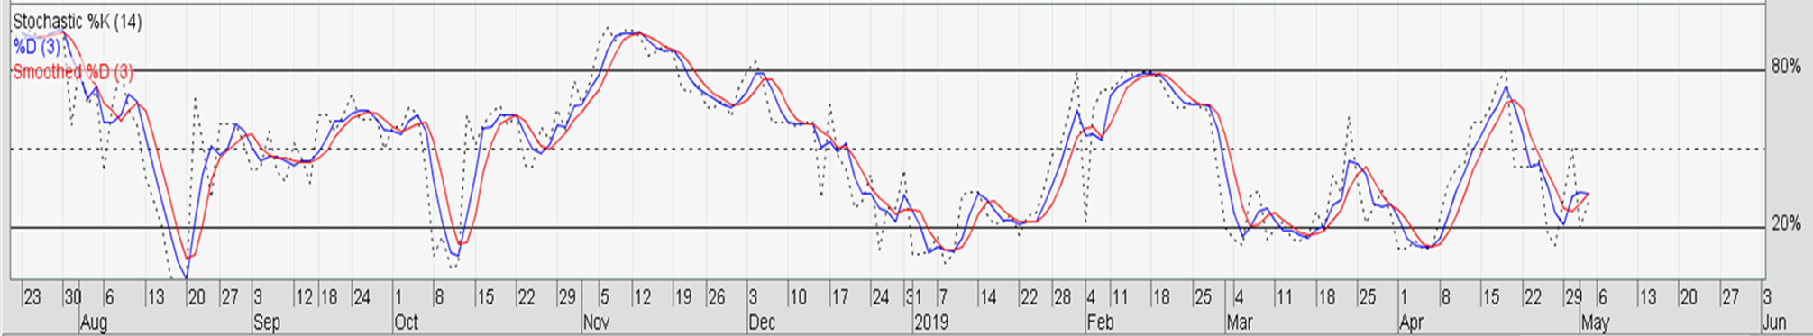
The formula for calculation of %K is:
  where C is the most recent close, L5 is the lowest low for the last five trading periods, and H5 is the highest high for the same five trading periods.
Remember that the calculation of stochastic indicators differs from that of most other momentum indicators in that it requires high, low, and closing data for the calculation.
The stochastic formula is similar to the RSI in that the plots can never exceed 0 or 100, but in this case, it measures the closing price in relation to the total price range for a selected number of periods.
Reading:
in excess of 80 would put the closing price for the period near the top of the range,
a low reading under 20 would put it near the bottom of the range.

Slide 14
The second line, %D, is a smoothed version of the %K line. The normal value is three periods. The %D formula is as follows:
  where H3 is the three-period sum of (C – L5) and
  L3 is the three-period sum of (H5 – L5).
The momentum indicator that results from these calculations is two lines that fluctuate between 0 and 100. The %K line is usually plotted as a solid line, while the slower %D line is usually plotted as a dashed line.
The popularity of the stochastic indicator can no doubt be explained by the smooth manner in which it moves from an overbought to an oversold condition, lulling a trader into feeling that price trends are much more orderly than would appear from an observation of an RSI or an ROC indicator.
Longer-term time frames, used on monthly and weekly charts, ap pear to work much better than the shorter-term stochastics used on daily futures charts.

Slide 15
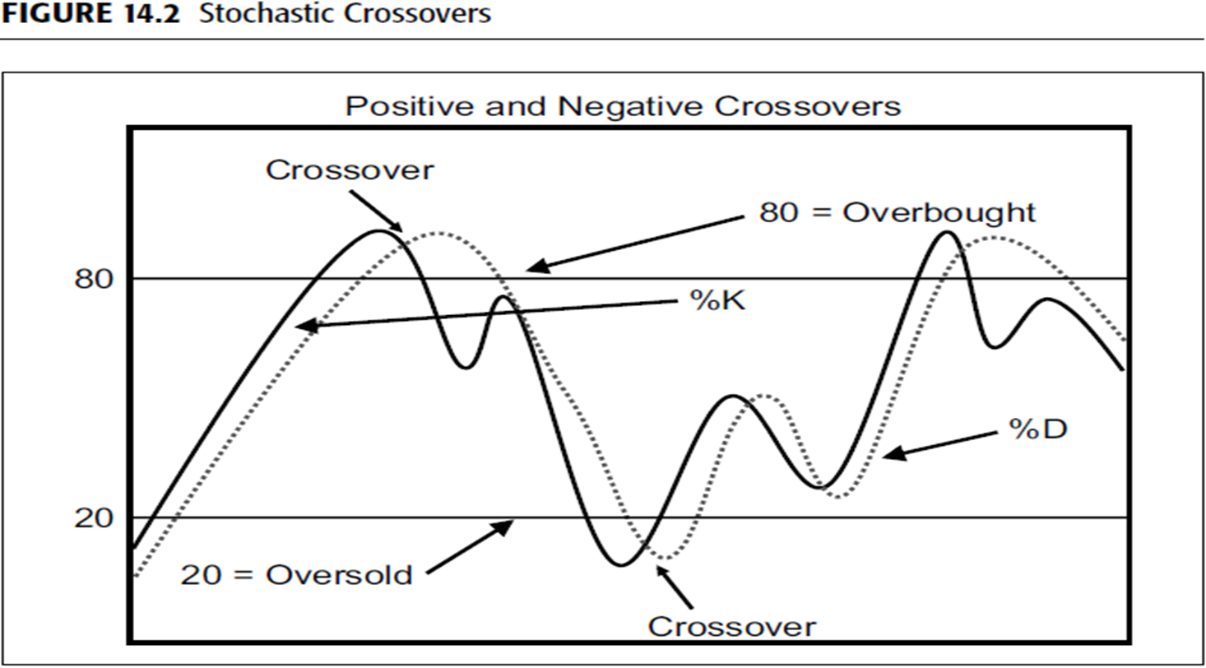
Stochastic Overbought and oversold bands for the stochastic are usually plotted in the 75 to 85 percent area on the upside and in the 15 to 25 percent area on the downside, depending on the time span in question.
  Overbought: >80. An overbought indication is given when the %D line crosses the extreme band (crossover),
      But actual sell alert is not indicated until the %K line crosses %D from above to below it.
  Oversold: <20 (default setting). An oversold indication is given when the %D line crosses the extreme low band (crossover),
      But actual BUY alert is not indicated until the %K line crosses %D from below to above it.
  When the two lines cross, they behave very similarly to a dual MA system. If you wait for the penetration, you can avoid getting trapped into shorting a strongly bullish move or buying an extremely negative one.
SELL
%K
%D
BUY

Slide 16
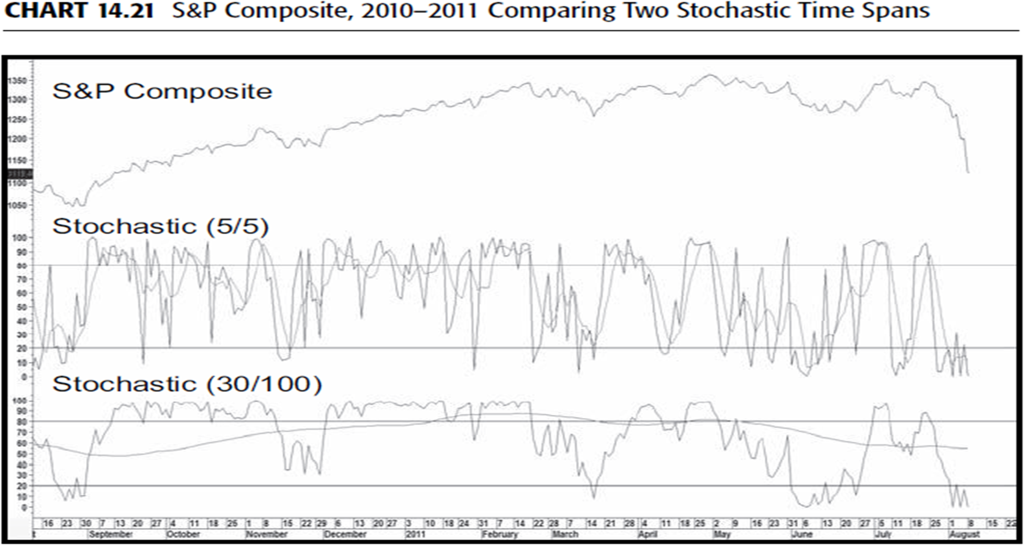
The behavior of the indicator will depend very much on the selected time frames. Since the %K and %D can be thought of as moving averages, it follows that the longer the time span, the smoother the resultant indicator.
The upper panel of Chart 14.21 shows a very volatile 5/5 combination, whereas the lower window contains a 30/100 combination.
Note that the %K is much less volatile than that in the upper window. The same is true for the 100 parameter used in the %D.
However, it is so flat that it is essentially useless from the point of view of reflecting the cyclic rhythms. In reality, one would never use such a combination.

Slide 17
Slowed Stochastic
  NOTE: 3 Lines in Slowed Stochastic:
  %K
  %D
  %Dn or the Smooth %D.
It is also possible (and desirable) to extend the calculation in order to invoke a slowed version of the stochastic.
  In this instance, the %K line is replaced with the %D line, and another MA is calculated for the %Dn (%D and %Dn or the Smooth %D).
Many technicians argue that this modified stochastic version gives more accurate signals. It certainly results in a more deliberate action.

Slide 18
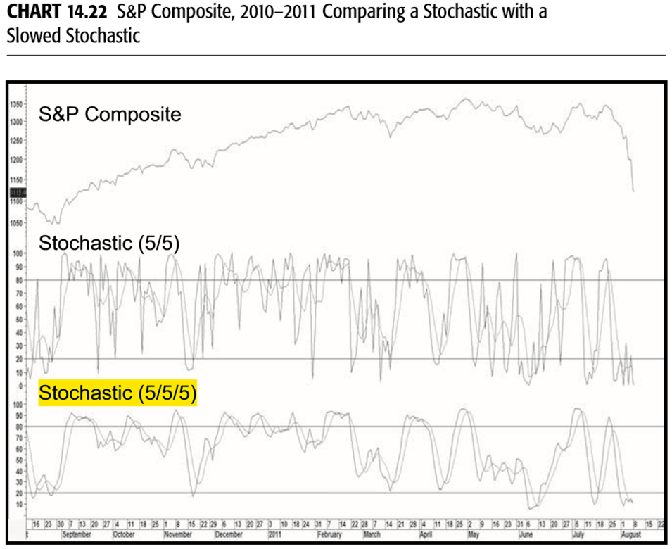
Slowed Stochastic
  NOTE: 3 Lines in Slowed Stochastic:
  %K
  %D
  %Dn or the Smooth %D).
A comparison between a regular and a slowed stochastic is featured in Chart 14.22.
The 5/5 in the upper window legend refers to a 5 period for the %K and D, respectively. The 5 in the middle of the lower window legend refers to the slowing factor. Chart 14.22 compares a regular stochastic to a slowed one.

Slide 19
Slowed Stochastic
Overbought and Oversold Position
  Overbought: >80,
  SELL @Overbought: A selling indication is given when the %D line crosses the %Dn @ Smooth %D (crossover) from above to below.
  Oversold: <20 (default setting).
  BUY @Oversold: A buying indication is given when the %D line crosses the %Dn @ Smooth %D (crossover) from below.
SELL
%D
%Dn
BUY

Slide 20
General Interpretation
Crossovers Normally, the faster %K line changes direction sooner than the %D line. This means that the crossover will occur before the %D line has reversed direction, as in Figure 14.2.
Divergences Figure 14.3 shows examples of where the %K fails to confirm a new high or low in the price, thereby setting up a divergence, which when confirmed, signals a change in trend.
Divergence Failure An important indication of a possible change in trend arises when the %K line crosses the %D line, moves back to test its extreme level, and fails to cross the %D line, as in Figure 14.4.
Once again, it is always important to see some price confirmation, and that is given with the break above the down trendline in the right side of the diagram.

Slide 21
General Interpretation
Reverse Divergence Occasionally during an uptrend, the %D line will make a lower low, which is associated with a higher low in the price, as shown in Figure 14.5. This is a bearish omen, and conventional wisdom suggests looking for a selling opportunity on the next rally. This condition is sometimes referred to as a bear setup. A positive reverse divergence is featured in Figure 14.6.
Extremes Occasionally the %K value reaches the extreme of 100 or 0. This indicates that a very powerful move is under way, since the price is consistently closing near its high or low. If a successful test of this extreme occurs following a pullback, it is usually an excellent entry point.
Hinge When either the %K line or the %D line experiences a slowdown in velocity, indicated by a flattening line, the indication is usually that a reversal will take place in the next period. Examples are shown in Figure14.7 and Chart 14.24 in the form of a 10-minute chart for Pfizer.

Slide 22
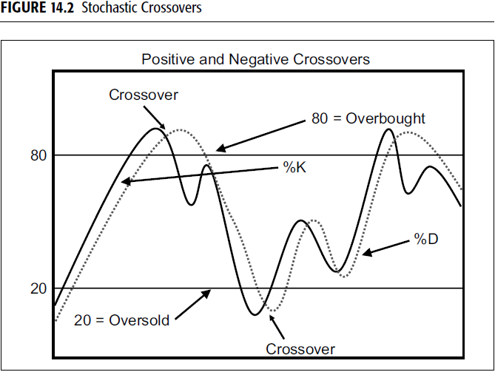
Crossovers:
Normally, the faster %K line changes direction sooner than the %D line. This means that the crossover will occur before the %D line has reversed direction, as in Figure 14.2.

Slide 23
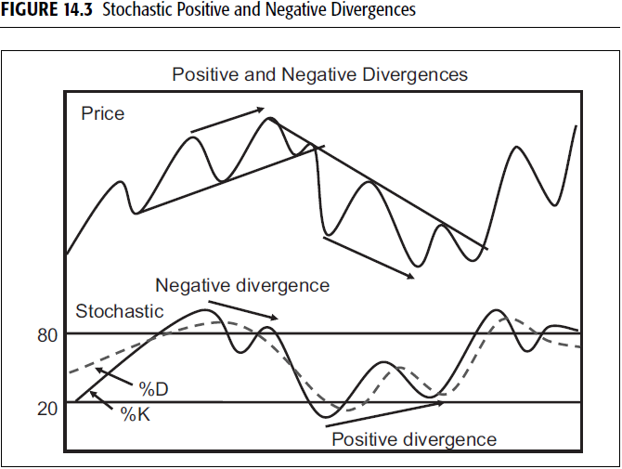
Divergences
Figure 14.3 shows examples of where the %K fails to confirm a new high or low in the price, thereby setting up a divergence, which when confirmed, signals a change in trend.
Divergence is where the Price line and the Stochastic line moves in a different direction.
This signal a change of trend:
Negative Divergence: Price Line upwards, Stochastic Line Downwards = Bearish signal.
Positive Divergence: Price Line Downwards, Stochastic Line Upwards = Bullish signal.

Slide 24
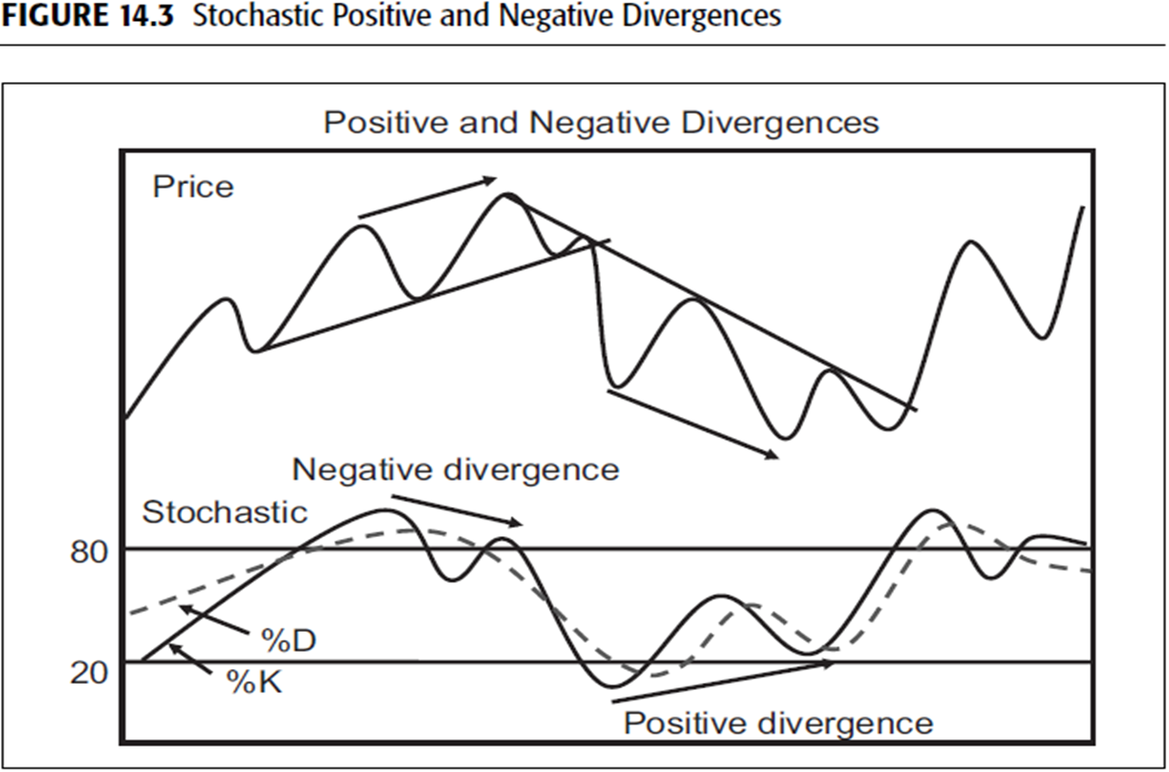
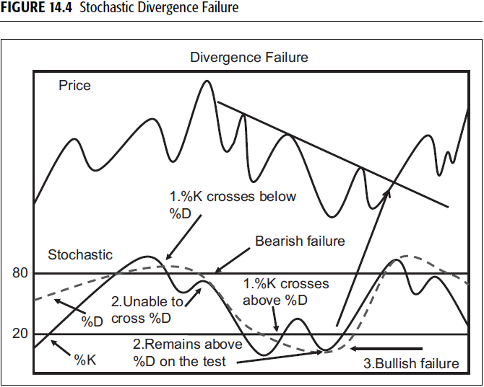
Divergence Failure
An important indication of a possible change in trend arises when the %K line crosses the %D line, moves back to test its extreme level, and fails to cross the %D line, as in Figure 14.4.

Slide 25
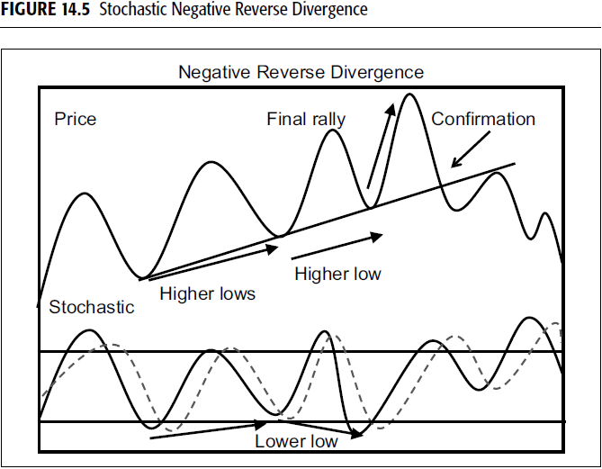
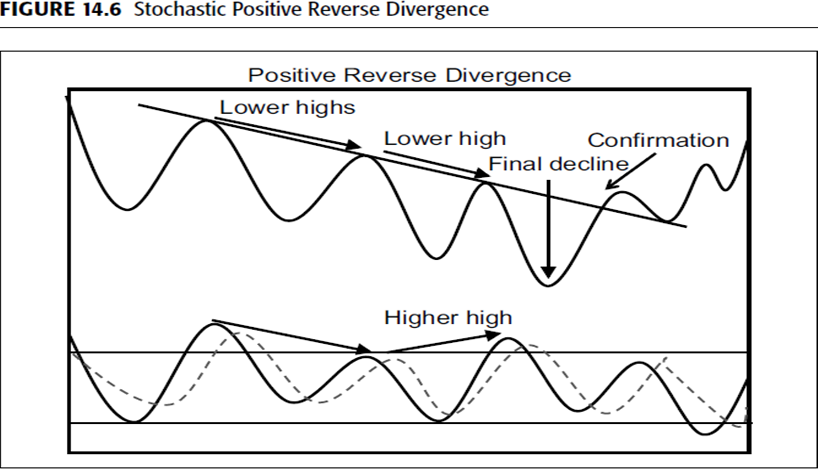
Reverse Divergence
Occasionally during an uptrend, the %D line will make a lower low, which is associated with a higher low in the price, as shown in Figure 14.5.
This is a bearish omen, and conventional wisdom suggests looking for a selling opportunity on the next rally.
This condition is sometimes referred to as a bear setup. A positive reverse divergence is featured in Figure 14.6

Slide 26
Extremes
Occasionally the %K value reaches the extreme of 100 or 0. This indicates that a very powerful move is under way, since the price is consistently closing near its high or low.
If a successful test of this extreme occurs following a pullback, it is usually an excellent entry point.

Slide 27
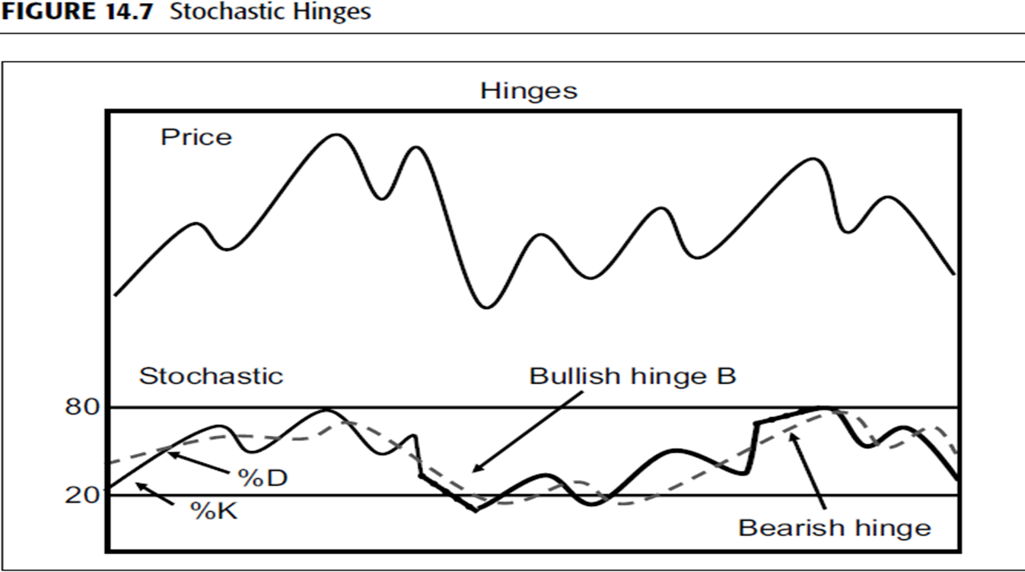
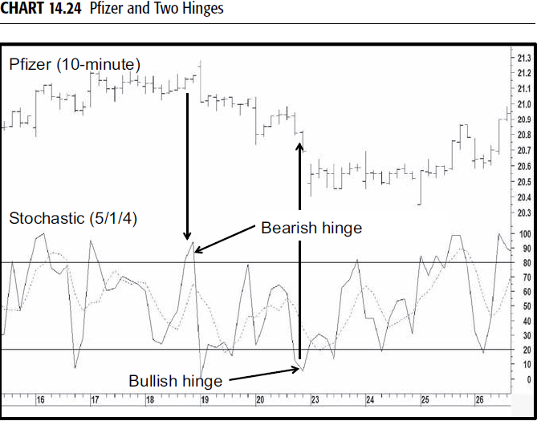
Hinge
When either the %K line or the %D line experiences a slowdown in velocity, indicated by a flattening line, the indication is usually that a reversal will take place in the next period.
Examples are shown in Figure14.7 and Chart 14.24 in the form of a 10-minute chart for Pfizer.

Slide 28
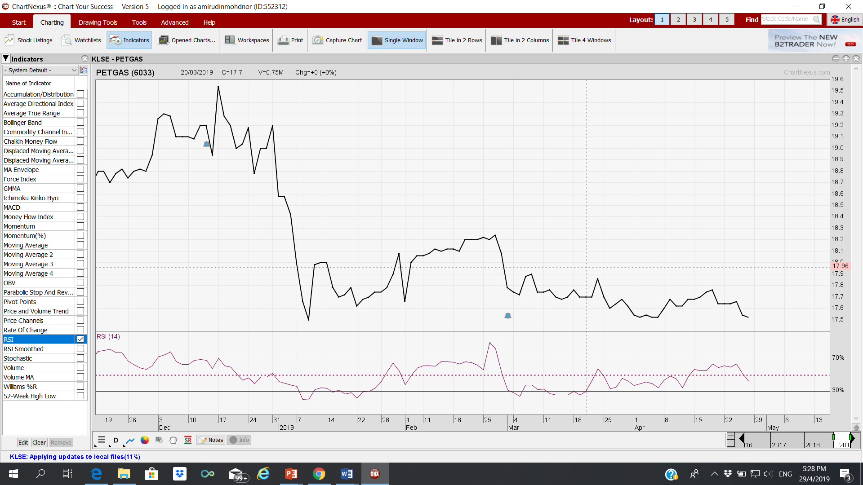
MOMENTUM INDICATOR 2:
RELATIVE STRENGTH INDEX- (RSI)
Wells Wilder.
Default time span recommended by Wilder is 14 days

Slide 29
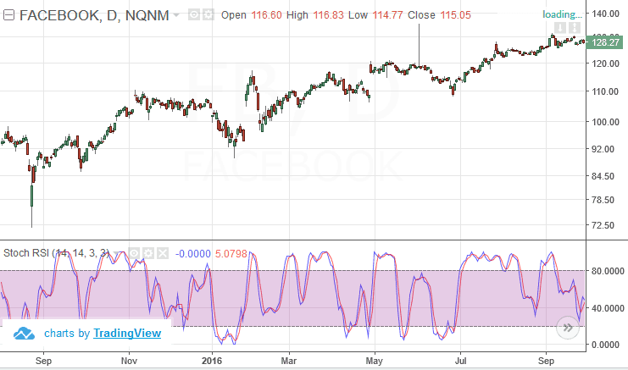
TECHNICAL INDICATORS - RSI
Relative Strength Index is a simple indicator that helps ascertain the best time to make a buy/sell call.
The RSI is generally used to:
  Generate buy and sell signals
  Show overbought and oversold conditions
  Confirm price movement
  Warn of potential price reversals through divergences
As RSI is an indicator that uses average, it has a normal range between 30% and 70% of the maximum range.

Slide 30

THE RSI
An oscillator, the RSI acts as a metric for price changes and the speed at which they change. The indicator fluctuates back and forth between zero and 100.
The Formula
The relative strength indicator (RSI) was developed by Wells Wilder.
It is a momentum indicator, or oscillator, that measures the relative internal strength of a stock or market against itself, instead of comparing one asset with another, or a stock with a market.
The formula for the RSI is as follows:
Where RS = the average of x days’ up closes divided by the average of x days’ down closes.
The indicator’s design aims to overcome two problems involved in construction of a momentum indicator: (1) erratic movements and (2) the need for a constant trading band for comparison purposes.
The RSI formula not only provides this smoothing characteristic, but also results in an indicator that fluctuates in a constant range between 0 and l00.
The default time span recommended by Wilder is 14 days, which he justified on the basis that it was half of the 28-day lunar cycle.

Slide 31
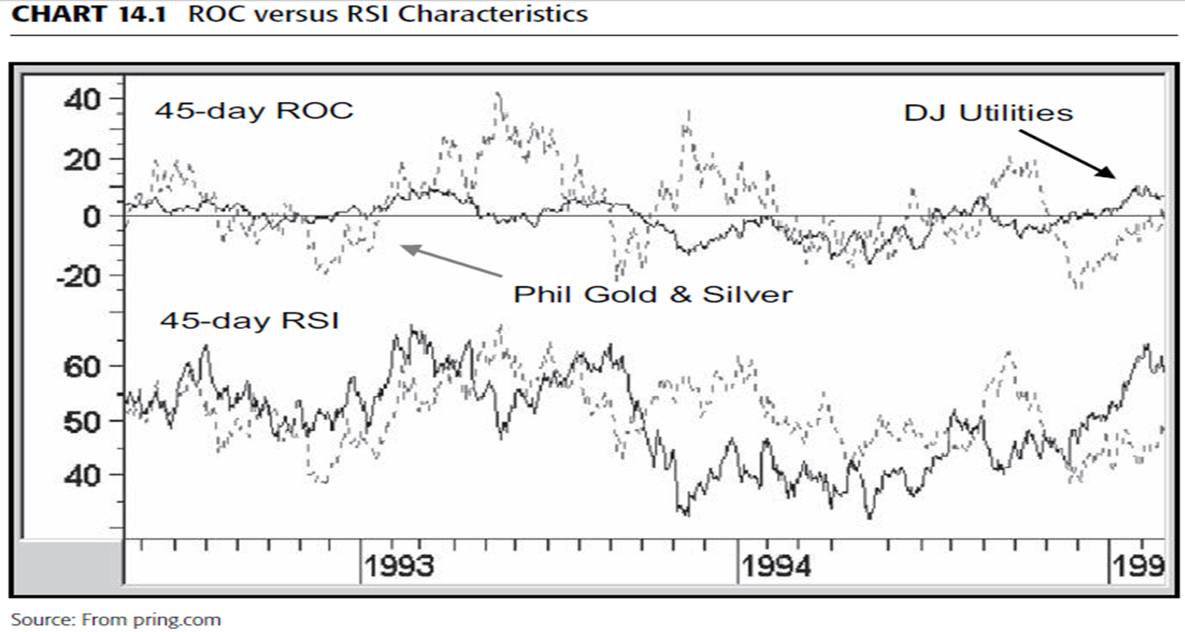
The RSI Is Useful for Making Comparisons Between Securities
The nature of the RSI calculation allows the accurate comparison of different securities on the same chart. In Chart 14.1 there are two series:

Slide 32
Constructing Overbought/Oversold Lines
Because of this, it is much easier to establish universal standards for the overbought and oversold benchmarks.
Using the 14-day default, they are traditionally set at 30 for oversold and 70 for overbought.
In an article entitled “How RSI Behaves,” Peter W. Aan argued that the average value of an RSI top and bottom occurred close to the 72 and 32 levels, respectively.
This research would indicate that the 70 and 30 levels recommended by Wilder should be moved further apart to better reflect the average overbought and oversold value.

Slide 33
Time Spans
The RSI can be plotted for any time span.
if you make the assumption that the primary trend of the stock market revolves around the 4-year business cycle, a moving average of 24 months will give you the greatest divergence between the high and low points of the cycle.
In the case of the 28-day cycle, 14 days is the correct choice, but it is important to understand that there are many other cycles.
Working on this assumption, for example, would mean that a 14-hour RSI would be inappropriate if the dominant cycle was something other than 28 hours. The same would be true for weekly and monthly data.

Slide 34
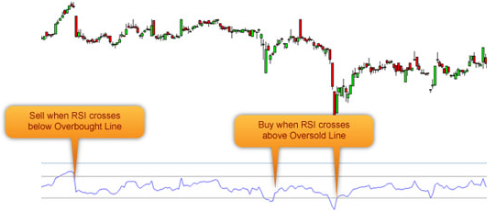
RSI
INTERPRETATION
Any rising RSI values above 50 signal positive, uptrend momentum. Conversely, RSI readings that decrease below 50 show negative, downtrend momentum.
Overbought: When the RSI crosses 70% level, the stock is considered overbought and it’s time to get out. (Sell signal)
Oversold: When the RSI is at 30%, the stock is considered oversold, and therefore it’s relatively attractive for traders to come in again. (Buy signal)

Slide 35
RSI Interpretation
Some of the principal methods used to interpret the RSI are as follows:
Extreme Readings and Failure Swings: Any time an RSI moves above its overbought or below its oversold zone, it indicates the security in question is ripe for a turn.
The significance depends upon the time. For example, the 45-hour RSI shown in Chart 14.7 is nowhere near as significant as an RSI constructed with a 12-month time span, as in Chart 14.4.
An overbought or oversold reading merely indicates that, in terms of probabilities, a counterreaction is overdone or overdue.
It presents an opportunity to consider liquidation or acquisition, but not an actual buy or sell signal.

Slide 36
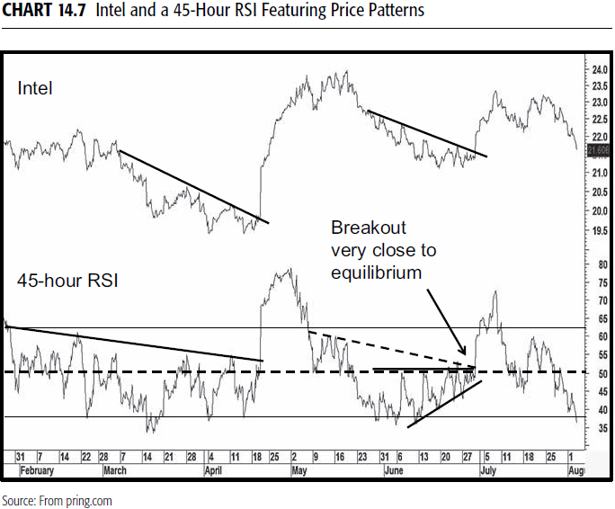

Slide 37
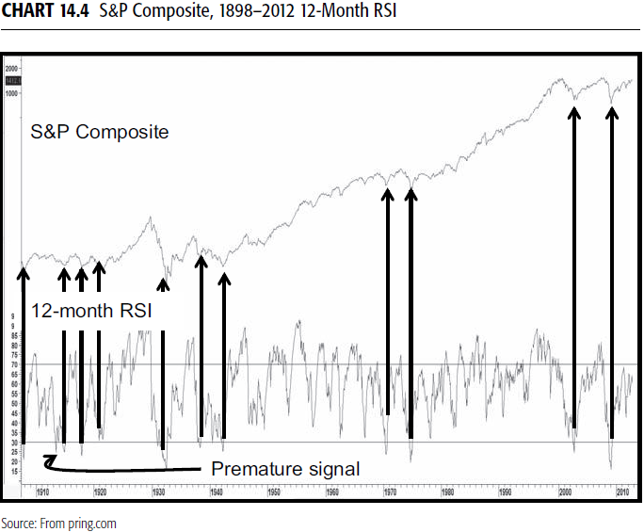

Slide 38
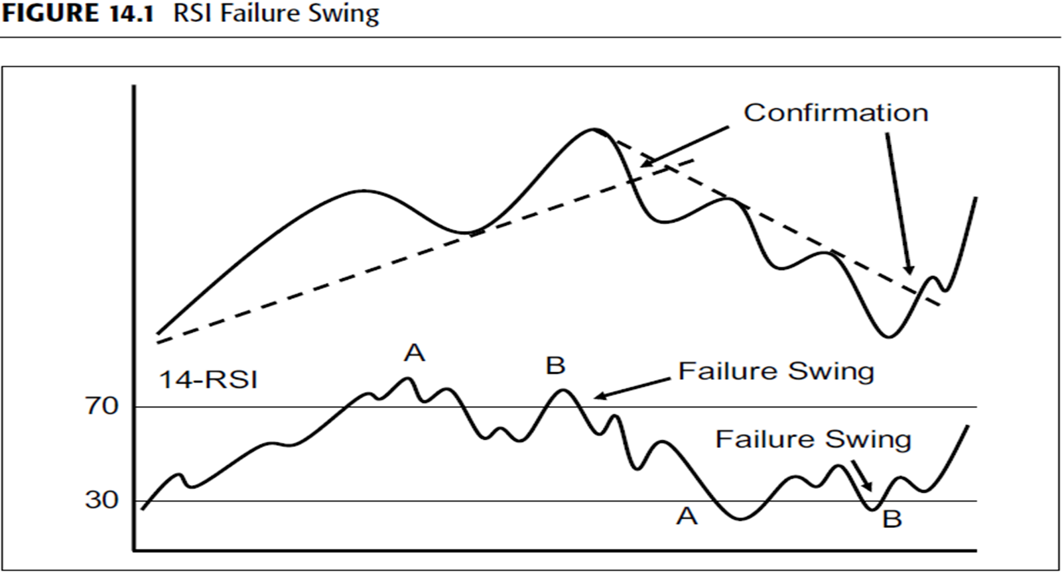
More often than not, the RSI traces out a divergence, as in Figure14.1.
In this case, the second crossover of the extreme level at points A and B usually offers good buy and sell alerts.
These divergences are often called failure swings.

Slide 39
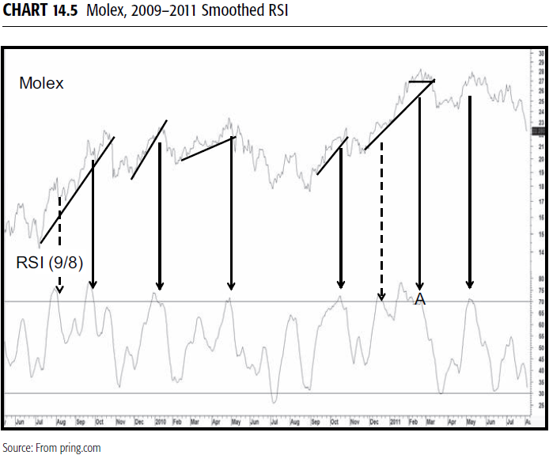
We see a bearish failure swing at the end of 2011 at point A in Chart14.5 featuring a smoothed version of a 9-day RSI.

Slide 40
Trendline Violations and Pattern Completions
The RSI can also be used in conjunction with trendline violations.
Generally speaking, the longer the time span for any particular period, i.e., daily, weekly, or monthly, the better the opportunity for trendline construction.
Important buy and sell signals are generated when:
  trendlines for both price and the RSI are violated within the equilibrium line at 50, it’s apparent that the strong late June breakout develops slightly above this critical point of balance.

Slide 41
Smoothing the RSI It is a perfectly legitimate technique to smooth the RSI.
One of my favorite approaches is to smooth a 9-day RSI with an 8-day moving average (MA).
Because the fluctuations are not as great as the raw data, the overbought/oversold lines are drawn at 70 and 30, not my usual default of 80/20 for a 9-day span.
Chart 14.5, featuring Molex, contains a 9-day RSI smoothed with an 8-day MA. The downward-pointing arrows flag all of the overbought reversals.
The solid ones show confirmed reversals with varying degrees of success. The dashed arrows indicate overbought reversals where it was not possible to construct a meaningful trendline. Needless to say, they were all failures.

